Slide 1
Clustering

Slide 2
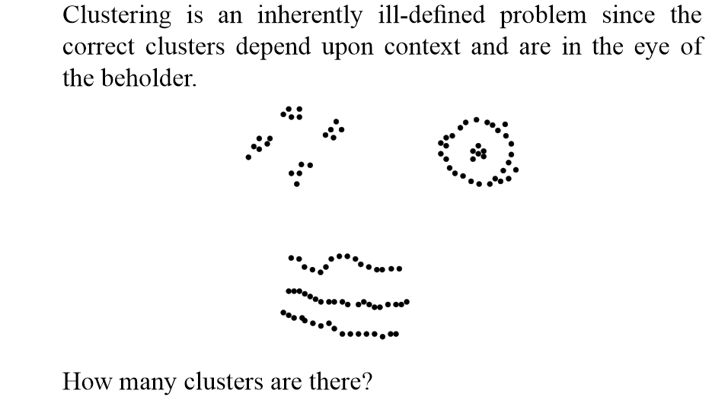

Slide 3
What do we need to cluster data?
Dataset of Points
Distance Function
Typical to assume a metric distance function

Slide 4
Quality of a cluster
A good clustering method will produce high quality clusters with
high intra-cluster similarity
low inter-cluster similarity

Slide 5
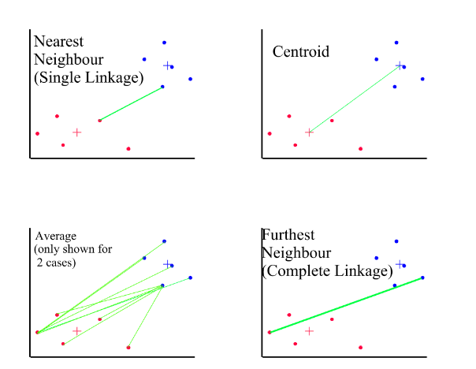
How do you measure the distance between two clusters?
O(1)
O(nm)
O(nm)
O(nm)

Slide 6
Distance between clusters
Single link: smallest distance between an element in one cluster and an element in the other, i.e., dis(K_{i}, K_{j}) = min(t_{ip}, t_{jq})
Complete link:, dis(K_{i}, K_{j}) = max(t_{ip}, t_{jq})
Average: avg distance between an element in one cluster and an element in the other, i.e., dis(K_{i}, K_{j}) = avg(t_{ip}, t_{jq})
Centroid: distance between the centroids of two clusters, i.e., dis(K_{i}, K_{j}) = dis(C_{i}, C_{j})

Slide 7
Major Clustering Approaches (I)
Hierarchical approach:
Create a hierarchical decomposition of the set of data (or objects) using some criterion
Typical methods: Single-linkage, Complete-linkage, BIRCH.
Partitioning approach:
Construct various partitions and then evaluate them by some criterion, e.g., minimizing the sum of square errors
Typical methods: k-means, k-medoids, CLARANS
Density-based approach:
Based on connectivity and density functions
Typical methods: DBSCAN, OPTICS, DenClue

Slide 8
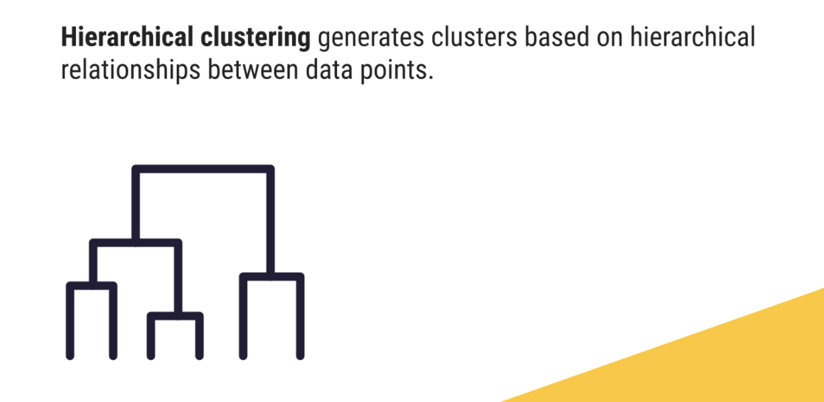
Hierarchical/Agglomerative Clustering

Slide 9
Agglomerative clustering
Each node/object is a cluster initially
Merge clusters that have the least dissimilarity
Ex: single-linkage, complete-linkage, etc.
Go on in a non-descending fashion
Eventually, all nodes belong to the same cluster

Slide 10
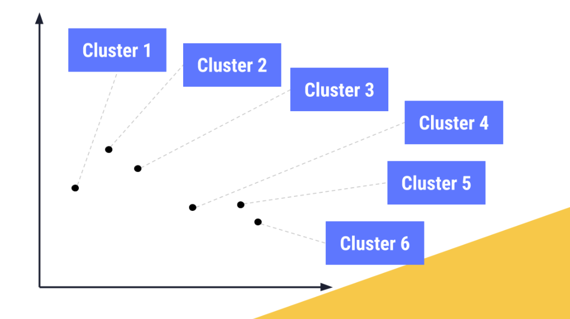
Initial Clusters

Slide 11
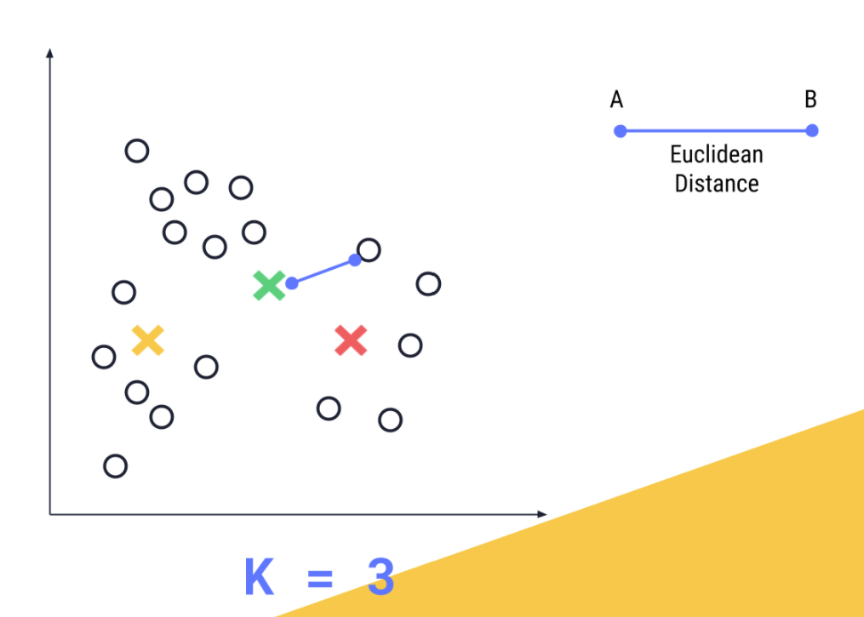
Find Distance

Slide 12
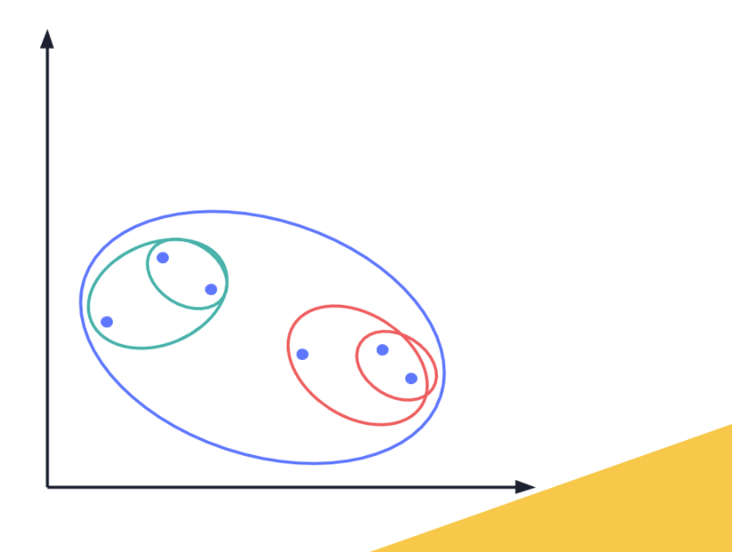
Merge Clusters

Slide 13
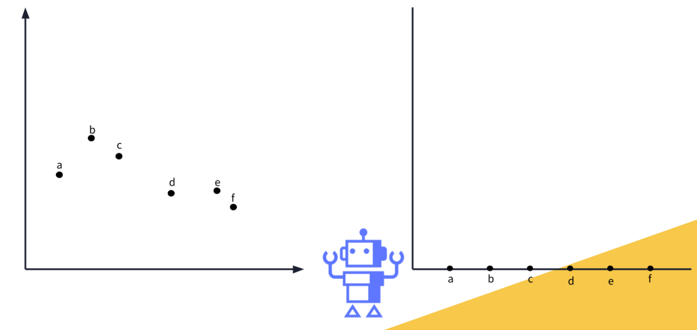
Dendogram

Slide 14
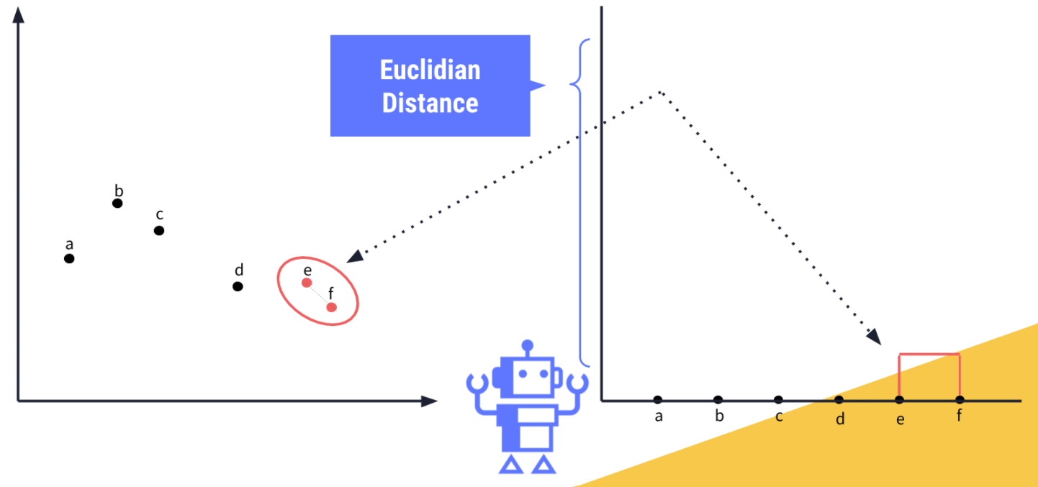
Dendogram

Slide 15
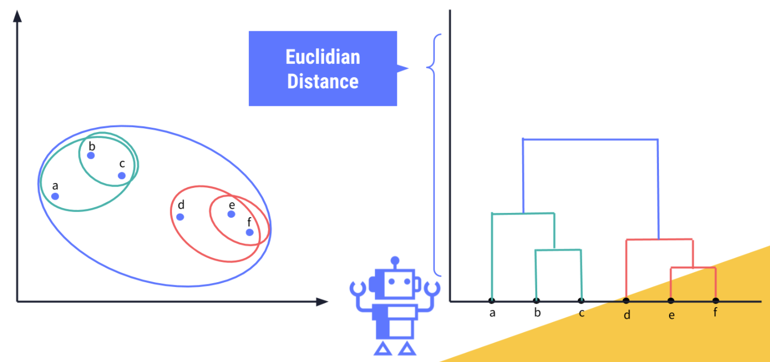
Dendogram

Slide 16
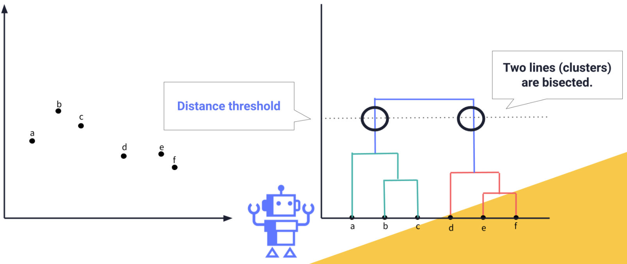
Optimal Clusters

Slide 17
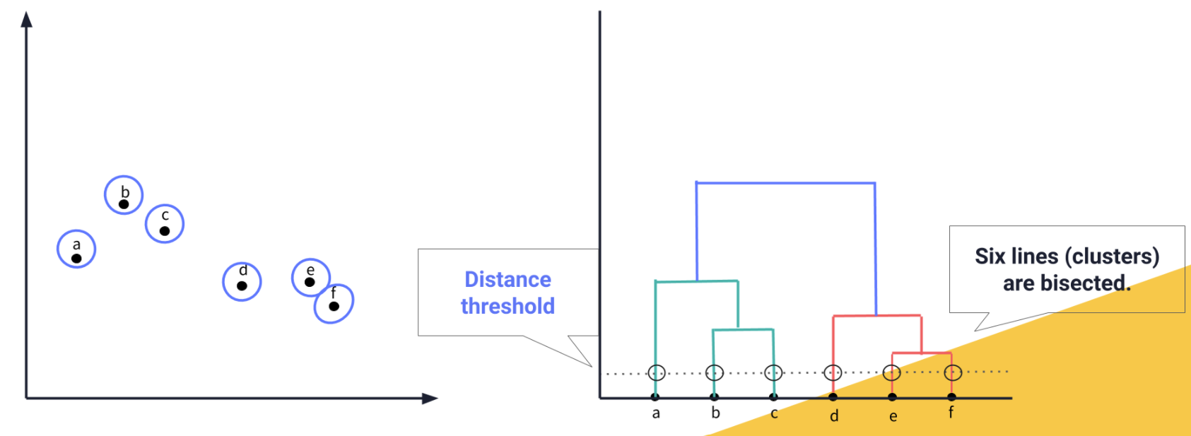
Optimal Clusters

Slide 18
Single Linkage vs. Complete Linkage (Cont.)
Complete linkage: Minimizes the diameter of the new cluster
Single linkage

Slide 19
Is complete-linkage better?
No! Depends on the dataset

Slide 20
The K-Means Clustering Method
Given k, the k-means algorithm is implemented in four steps:
Randomly select k points as cluster centers
Assign all remaining points to the closest cluster center
Recompute centroid: the centroid is the center, i.e., mean point, of the cluster
Go back to Step 2 till cluster centers converge.

Slide 21
The K-Means Clustering Method
Example
10
10
9
9
8
8
7
7
6
6
5
5
4
Assign each objects to most similar center
Update the cluster means
4
3
3
2
2
1
1
0
0
0
1
2
3
4
5
6
7
8
9
10
0
1
2
3
4
5
6
7
8
9
10
reassign
reassign
K=2
Arbitrarily choose K objects as initial cluster centers
Update the cluster means

Slide 22
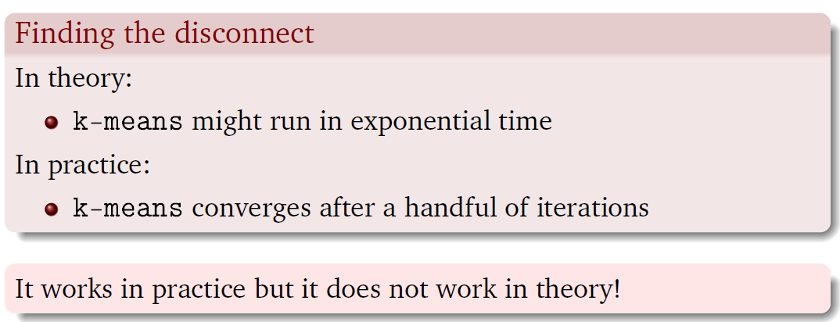
Properties of k-means
Complexity
Time
O(ikn)
i is the number of iterations
Will it converge?

Slide 23
Properties of k-means
How do you select the initial k clusters?
This is a black art.
Just apply your heuristic and hope it works
Choose diverse centers
How do you find out the value of k?
Identify the value of k where cluster quality is best
Heuristic: Elbow plot

Slide 24
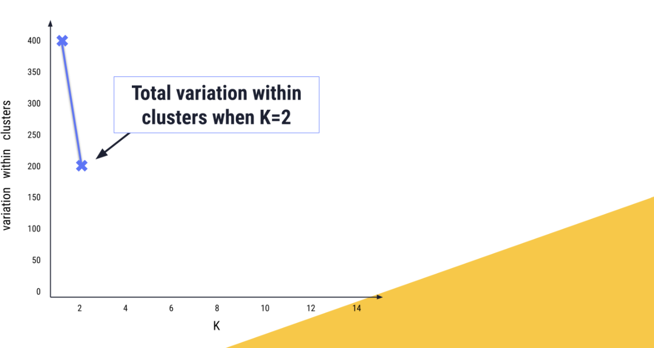
Elbow plot

Slide 25
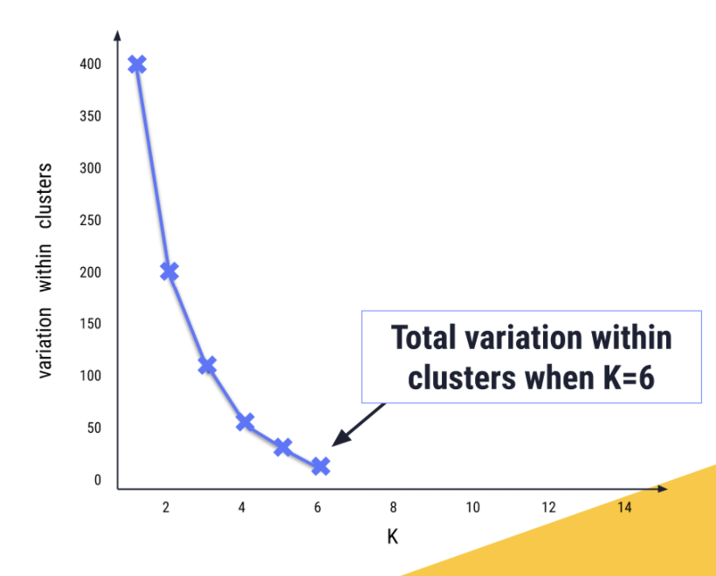
Elbow plot

Slide 26
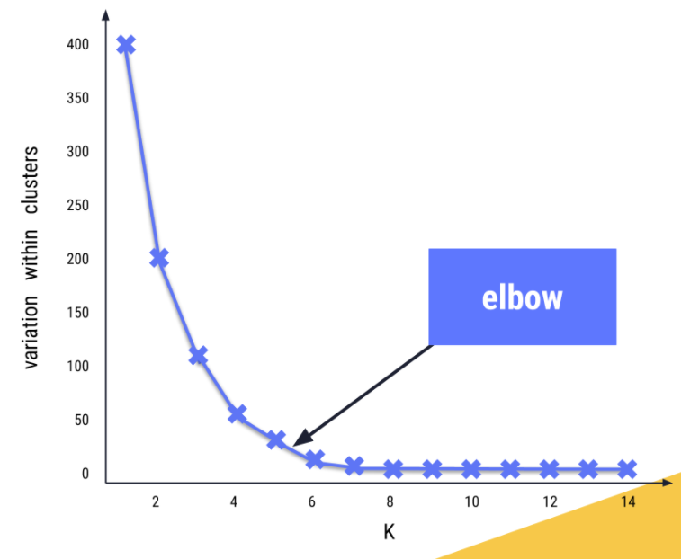
Elbow plot

Slide 27
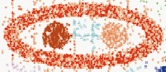
Weakness of k-means
Can it identify clusters of all shapes?
Limited to convex shapes
Prone to noise
Outliers generate spurious centroids
How do you cluster non-vector data?
Text
Graphs
Time-series

Slide 28
The K-Medoids Clustering Method
Find representative objects, called medoids, in clusters
Select k representative objects arbitrarily as centroids
Assign remaining points to the closest centroid
For each cluster, select the object that minimizes the total distance all other points in the cluster as the new centroid
Other techniques exist to check if the quality of a cluster improves with new centroid.
repeat steps 2-3 until there is no change

Slide 29
Properties of k-medoid
Strengths
more robust than k-means in the presence of outliers
Applicable to non-vector data
It is only a function of the distance and not the co-ordinates
Weakness
More expensive
Time Complexity: O(in²) , i is the number of iterations

Slide 30
Density-Based Clustering Methods
Clustering based on density (local cluster criterion), such as density-connected points
Major features:
Discover clusters of arbitrary shape
Handle noise
Need density parameters as termination condition
Several interesting studies:
DBSCAN: Ester, et al. (KDD’96)
OPTICS: Ankerst, et al (SIGMOD’99).
DENCLUE: Hinneburg & D. Keim (KDD’98)
CLIQUE: Agrawal, et al. (SIGMOD’98) (more grid-based)

Slide 31
Weakness of k-means/k-medoid?

Slide 32
Density-Based Clustering: Basic Concepts
Ester, Martin; Kriegel, Hans-Peter; Sander, Jörg; Xu, Xiaowei. A density-based algorithm for discovering clusters in large spatial databases with noise. KDD-96.
Two parameters:
Eps: Maximum radius of the neighborhood
MinPts: Minimum number of points in an Eps-neighborhood of that point
N_{Eps}(p): {q belongs to D | dist(p,q) <= Eps}
Directly density-reachable: A point p is directly density-reachable from a point q w.r.t. Eps, MinPts if
p belongs to N_{Eps}(q)
core point condition:
|N_{Eps} (q)| >= MinPts
p
MinPts = 5
Eps = 1 cm
q

Slide 33
Density-Reachable and Density-Connected
Density-reachable:
A point p is density-reachable from a point q if there is a chain of points p₁, …, p_{n}, p₁ = q, p_{n} = p such that p_{i+1} is directly density-reachable from p_{i}
Is this symmetric?
NO.
Density-connected
A point p is density-connected to a point q w.r.t. Eps, MinPts if there is a point o such that both, p and q are density-reachable from o w.r.t. Eps and MinPts
p
p₁
q
p
q
o

Slide 34
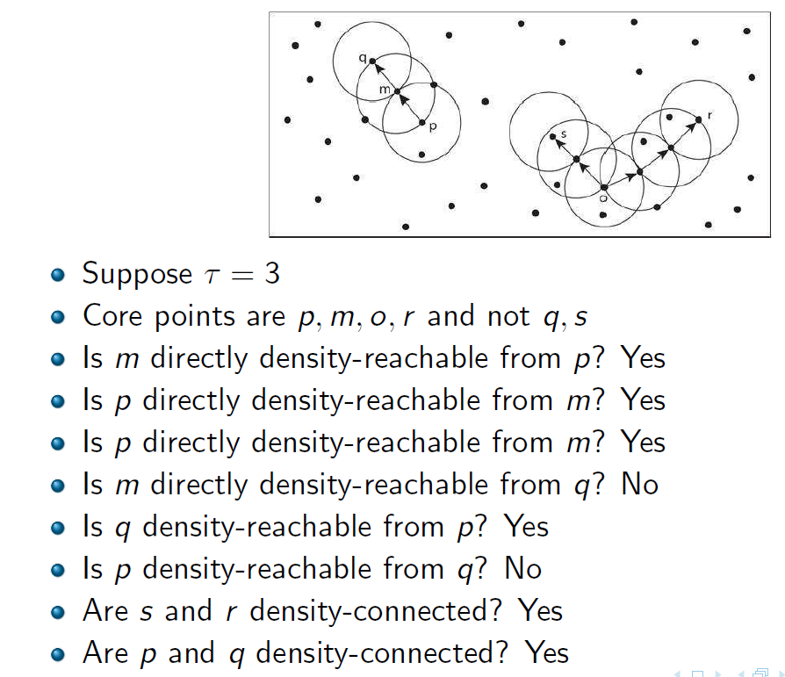
Example…
?

Slide 35
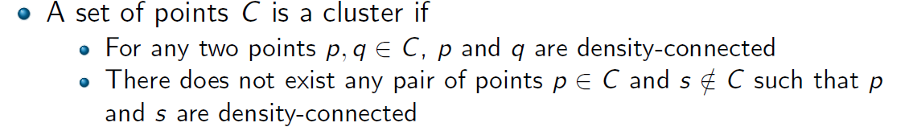
DBSCAN: Density Based Spatial Clustering of Applications with Noise
Outlier
Border
Eps = 1cm
MinPts = 5
Core

Slide 36
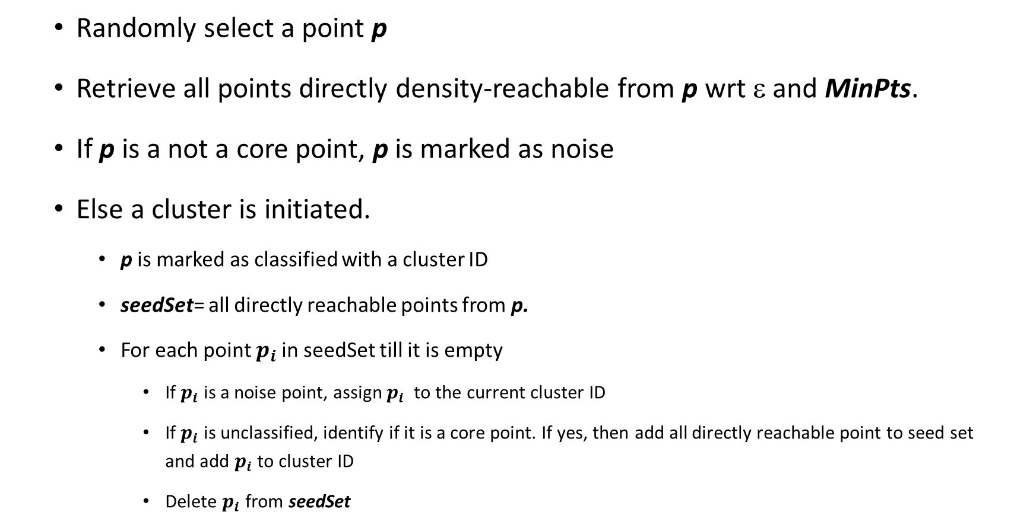
DBSCAN: The Algorithm (You must read the paper)
Randomly select a point p
Retrieve all points directly density-reachable from p wrt ε and MinPts.
If p is a not a core point, p is marked as noise
Else a cluster is initiated.
p is marked as classified with a cluster ID
seedSet= all directly reachable points from p.
For each point $p_{i}$in seedSet till it is empty
If $p_{i}$ is a noise point, assign $p_{i}$ to the current cluster ID
If $p_{i}$ is unclassified, identify if it is a core point. If yes, then add all directly reachable point to seed set and add $p_{i}$ to cluster ID
Delete $p_{i}$ from seedSet

Slide 37
DBSCAN: Properties
Can discover clusters of arbitrary shapes
Complexity
Time
O(n²)
O(nlog^{d-1}n) with range tree. But requires more storage
d dimensions
Weakness?
Parameter sensitive

Slide 38
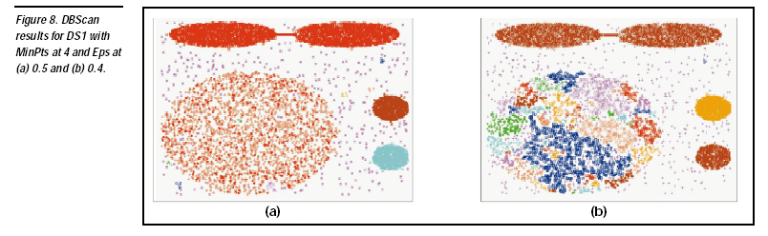
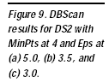
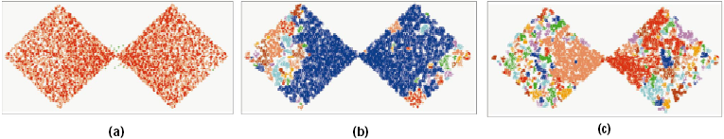
DBSCAN: Sensitive to Parameters

Slide 39
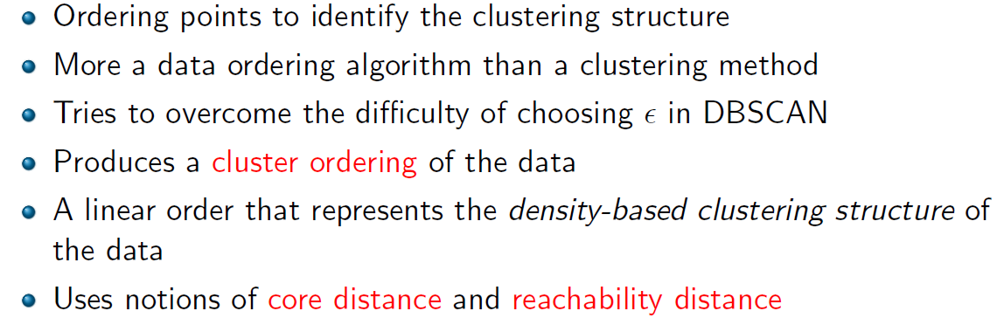
OPTICS: A Cluster-Ordering Method
Mihael Ankerst, Markus M. Breunig, Hans-Peter Kriegel, Jörg Sander (1999). OPTICS: Ordering Points To Identify the Clustering Structure. ACM SIGMOD international conference on Management of data.

Slide 40
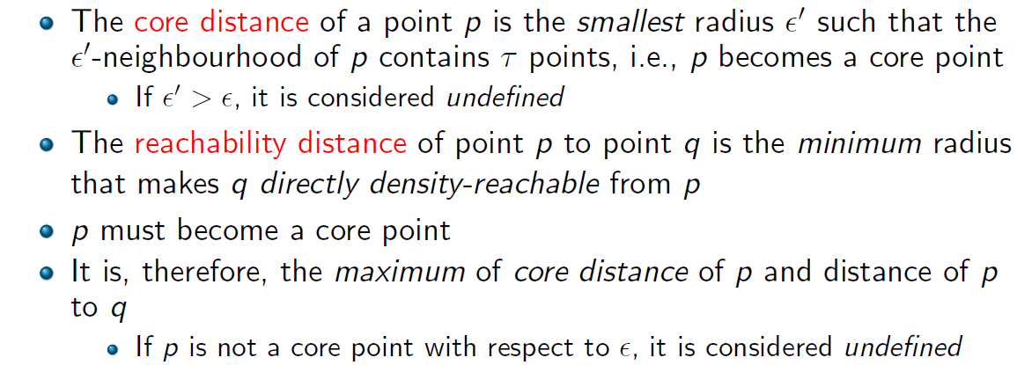
Definitions
MinPts = 3
ε
Reachability Distance
ε’
This point has an undefined reachability distance.

Slide 41
Get Neighbors, Calc Core Distance,
Save Current Object
Calc/Update Reachability Distances
Update Processing Order
ε’
ε
ε
=> pt1 ε’ :10 rd:NULL
ε’
=> pt2 5 10
…
=> pt3 7 5

Slide 42
Reachability Plots
A reachability plot is a bar chart that shows each object’s reachability distance in the order the object was processed. These plots clearly show the cluster structure of the data.
2
1
2
>ε
1
4
5
4
5
3
3
7
7
6
6
n

Slide 43
Reachability-distance
undefined
‘
Cluster-order of the objects

Slide 44
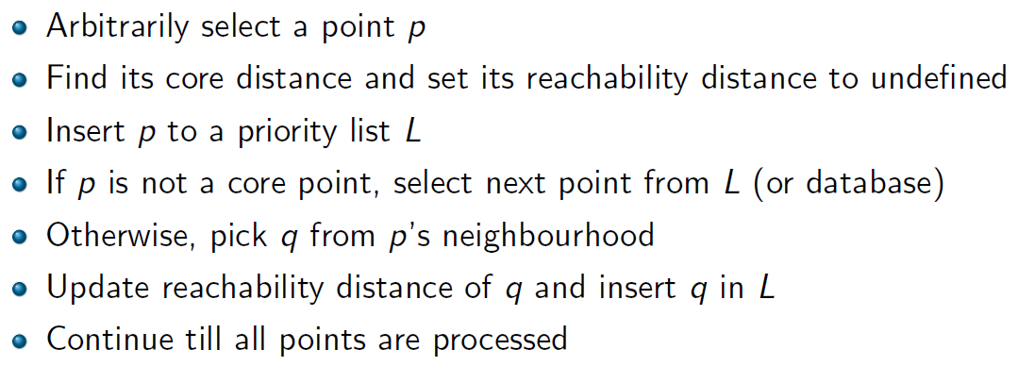
Algorithm

Slide 45
Automatic Cluster Extraction
A steep upward point is a point that is t% lower that its successor. A steep downward point is similarly defined.
A steep upward area is
a region from [s, e] such that s and e are both steep upward points,
each successive point is at least as high as its predecessors, and
the region does not contain more than MinPts successive points that are not steep upward.
A cluster:
Starts with a steep downward area
Ends with a steep upward area
Contains at least MinPts

Slide 46
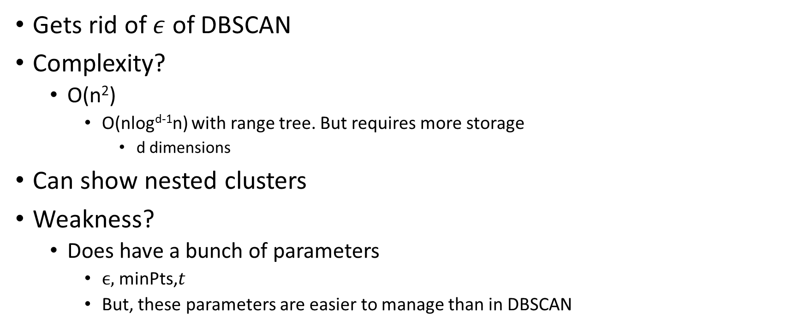
Properties
Gets rid of $ε$ of DBSCAN
Complexity?
O(n²)
O(nlog^{d-1}n) with range tree. But requires more storage
d dimensions
Can show nested clusters
Weakness?
Does have a bunch of parameters
$ϵ,$minPts,$t$
But, these parameters are easier to manage than in DBSCAN

Slide 47
Let’s think bigger..
Typical scenario
Load entire database to main memory
Cluster data
What happens when the data is too large to fit in main memory?
Options:
Distribute and Parallelize?
Sample?

Slide 48
K-means through sampling
Sample enough data that can be fit into memory
Cluster sample
Assign remaining objects to the closest cluster center
Issues:
Number of clusters may not be correct
Cluster centers may not be correct
Notes:
How do you split the data?
How do you choose k in each split?

Slide 49
BFR
BFR (Bradley-Fayyad-Reina) is a variant of k -means designed to handle very large (disk-resident) data sets.
It assumes that clusters are normally distributed around a centroid in a Euclidean space.
Standard deviations in different dimensions may vary.

Slide 50
BFR – (2)
Points are read one main-memory-full at a time.
Most points from previous memory loads are summarized by simple statistics.
To begin, from the initial load we select the initial k centroids by some sensible approach.

Slide 51
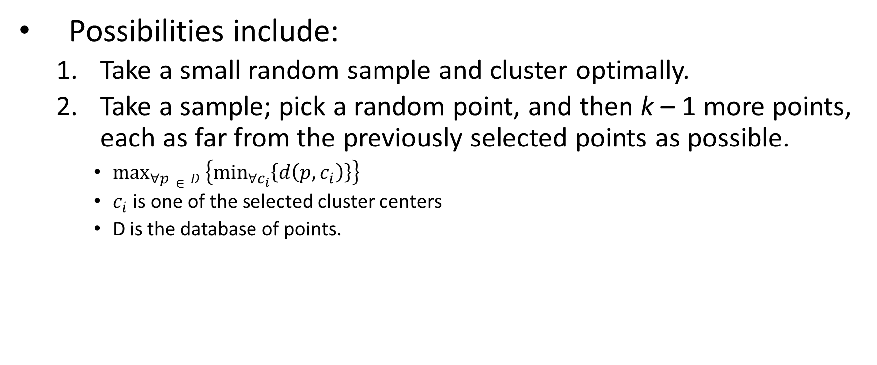
Initialization: k -Means
Possibilities include:
Take a small random sample and cluster optimally.
Take a sample; pick a random point, and then k – 1 more points, each as far from the previously selected points as possible.
$\max_{∀p}∈D\left\{\min_{∀c_{i}}\left\{d\left(p,c_{i}\right)\right\}\right\}$
$c_{i}$ is one of the selected cluster centers
D is the database of points.

Slide 52
Three Classes of Points
The discard set : points close enough to a centroid to be summarized.
The compression set : groups of points that are close together but not close to any centroid. They are summarized, but not assigned to a cluster.
The retained set : isolated points.

Slide 53
“Galaxies” Picture
Points in
the RS
Compressed sets.
Their points are in
the CS.
A cluster. Its points
are in the DS.
The centroid

Slide 54
Summarizing Sets of Points
For each cluster, the discard set is summarized by:
The number of points, N.
The vector SUM, whose i ^{th} component is the sum of the coordinates of the points in the i ^{th} dimension.
The vector SUMSQ: i ^{th} component = sum of squares of coordinates in i ^{th} dimension.
What’s special about these values?
Can I update the centroid if a new point is added to the cluster?
Can I compute variance?

Slide 55
Comments
Averages in each dimension (centroid coordinates) can be calculated easily as SUM_{i} /N.
SUM_{i} = i ^{th} component of SUM.
Variance of a cluster’s discard set in dimension i can be computed by: (SUMSQ_{i} /N ) – (SUM_{i} /N )²
And the standard deviation is the square root of that.

Slide 56
Storage
2d + 1 values per discard set.
d = number of dimensions.
The same statistics can represent any compression set.
No guarantees for Retained set

Slide 57
Processing a “Memory-Load” of Points
Find those points that are “sufficiently close” to a cluster centroid; add those points to that cluster and the DS.
Use any main-memory clustering algorithm to cluster the remaining points and the old RS.
Clusters go to the CS; outlying points to the RS.

Slide 58
Re-computing statistics
Adjust statistics of the clusters to account for the new points.
Add N’s, SUM’s, SUMSQ’s.
Consider merging compressed sets in the CS.
If this is the last round, merge all compressed sets in the CS and all RS points into their nearest cluster.
Alternatively, you could also term them as outliers if they are distant from all existing clusters.

Slide 59
A Few Details . . .
How do we decide if a point is “close enough” to a cluster that we will add the point to that cluster?
Assign to same cluster, if with a high probability it is similar to other points in the cluster
How do we decide whether two compressed sets deserve to be combined into one?

Slide 60
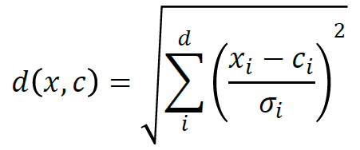
Normalized Euclidean distance
For point (x₁,…,x_{k}) and centroid (c₁,…,c_{k}):
Normalize in each dimension: y_{i} = (x_{i} -c_{i})/σ_{i}
Take sum of the squares of the y_{i} ’s.
Take the square root.
Any issues with this formulation?
Assumes dimensions are independent.

Slide 61
Normalized Euclidean distance
If clusters are normally distributed in d dimensions, then 66% of the points of the cluster will have a NED< √d.
Accept a point for a cluster if its NED is < some threshold, e.g. 4 standard deviations.

Slide 62
Should Two CS Subclusters Be Combined?
Compute the variance of the combined subcluster in each dimension.
Can I compute this?
N, SUM, and SUMSQ allow us to make that calculation quickly.
Combine if the variance is below some threshold.
Many alternatives: treat dimensions differently, consider density.

Slide 63
How is it different from k-means though sampling?
Instead of storing just the center, stores additional information about the cluster
Weakness:
Assumes points are normally distributed ➔ limited to convex shapes
Cannot split or drop a cluster after the initialization step
Can be applied to Euclidean space only
Assumes each dimension is independent

Slide 64
The CURE Algorithm
Problem with BFR/k -means:
Assumes clusters are normally distributed in each dimension.
CURE:
Clustering Using REpresentatives
Allows clusters to assume any shape.
Sudipto Guha, Rajeev Rastogi, and Kyuseok Shim. 1998. CURE: an efficient clustering algorithm for large databases. In Proceedings of the 1998 ACM SIGMOD international conference on Management of data (SIGMOD '98)

Slide 65
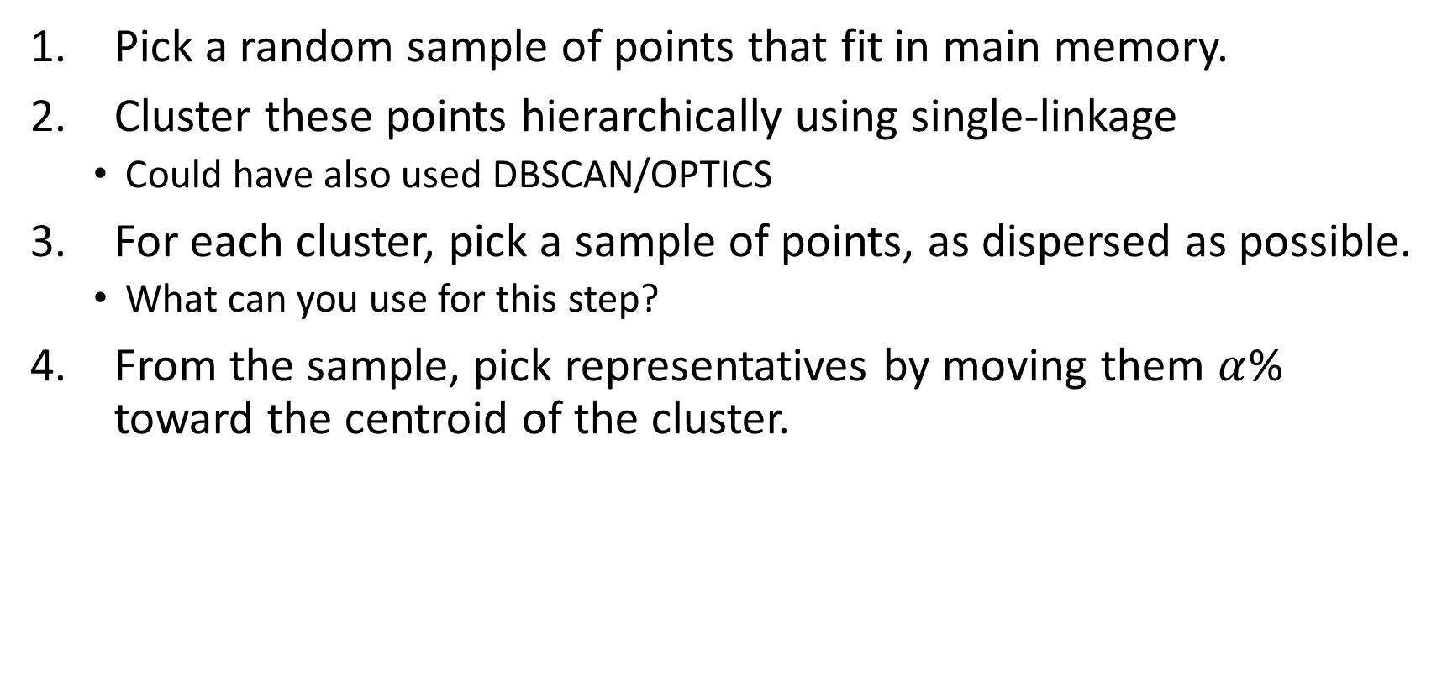
Starting CURE
Pick a random sample of points that fit in main memory.
Cluster these points hierarchically using single-linkage
Could have also used DBSCAN/OPTICS
For each cluster, pick a sample of points, as dispersed as possible.
What can you use for this step?
From the sample, pick representatives by moving them $α$% toward the centroid of the cluster.

Slide 66
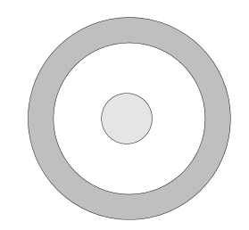
Step 1
Sample some random points from the database
Large database

Slide 67
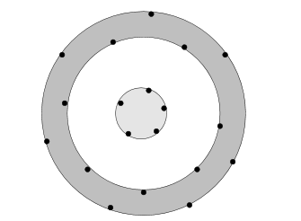
Step 2: Cluster points and identify points that are as dispersed as possible

Slide 68
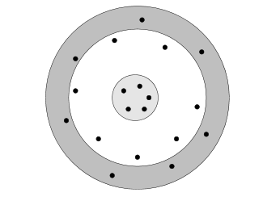
Move dispersed points towards the center
Representatives

Slide 69
What next?
If representatives of two clusters are too close merge them
Otherwise,
Now, visit each point p in the data set.
Place it in the “closest cluster.”
Normal definition of “closest”: that cluster with the closest representative to p

Slide 70
Why shrink the dispersed points?
More robust to noise.

Slide 71
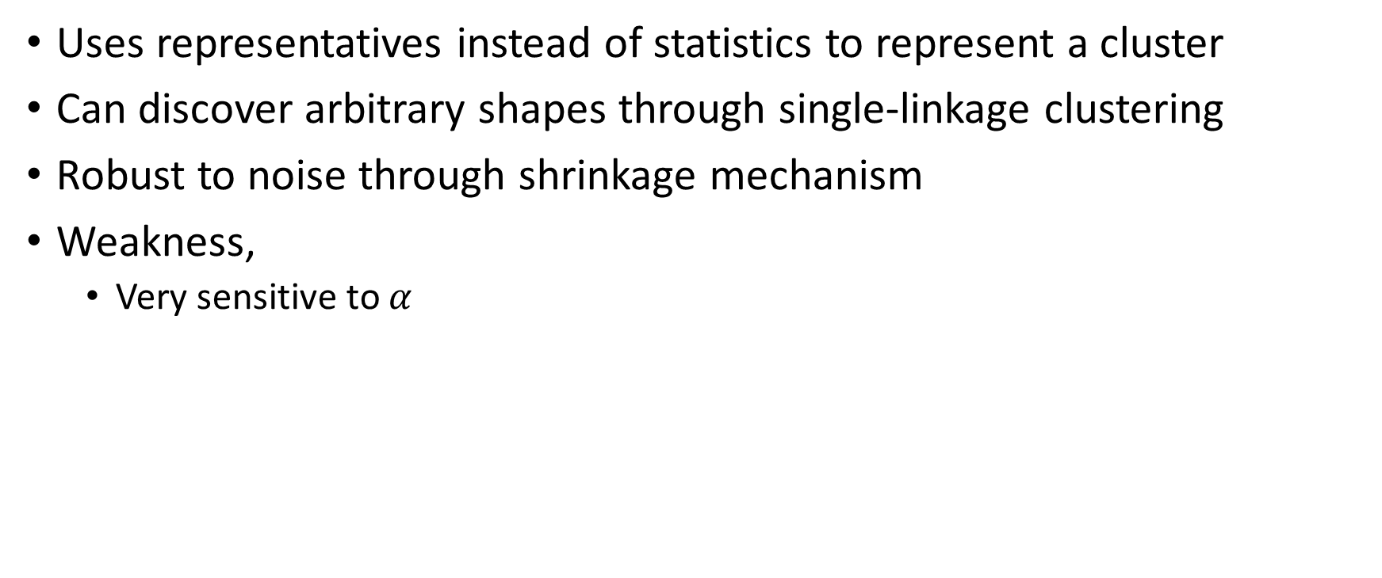
Comments
Uses representatives instead of statistics to represent a cluster
Can discover arbitrary shapes through single-linkage clustering
Robust to noise through shrinkage mechanism
Weakness,
Very sensitive to $α$

Slide 72
Bubble (ICDE 1999)
Scalable clustering in high-dimensional non-Euclidean spaces
Organize clusters in a tree
Each leaf contains multiple cluster descriptions
Similar clusters go to the same leaf
Non-leaves contain a sample of the cluster centers

Slide 73
Cluster description
For a cluster containing a set of objects C = {O₁…O_{n}}
Define:-
Rowsum (O) =
Clustroid (C ) is the object O with least Rowsum value.
Rowsum of the clustroid
Rowsum of the k closest points to clustroid in
close➔ almost equally low rowsum
Can become clustroid in the future
Rowsum of the k farthest points to clustroid
Can shift to a different cluster in the future
N = number of points in the cluster

Slide 74
Algorithm
Load enough points to the main memory
Cluster points
In a recursive-bottom up manner build a tree such that similar clusters are grouped together

Slide 75
c₂
c₉
c₁
c₃
C₃, C₅
c₈
Store cluster centers
c₄
C₁,C₃
C₅, C₈
c₅
c₆
c₇
C₃, C₄
C₅,C₆,C₇
C₈, C₉
C₁,C₂
Store cluster features

Slide 76
Given a new point…
Start traversing from the root
Identify branch with the closest cluster center
Follow branch recursively till a leaf node is reached.

Slide 77
c₂
c₉
c₁
c₃
C₃, C₅
c₈
Store cluster centers
c₄
C₁,C₃
C₅, C₈
c₅
c₆
c₇
C₃, C₄
C₅,C₆,C₇
C₈, C₉
C₁,C₂
Store cluster features

Slide 78
Consequences of inserting a point p
Update Cluster Feature
Add 1 to N
Update rowsum of all stored points
Cluster center
Farthest points
Closest points
Compute rowsum(p)=rowsum(c)+Nd²(p,c)
C is the cluster center
Why?

Slide 79
Consequences of inserting a point p..
Clustroid changes.
May need to merge clusters
Farthest points of two clusters are very close
May need to split cluster
Radius of cluster is too large
Based on split/merge bubble up the effect to the root

Slide 80
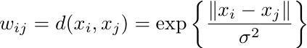
Clustering graphs
Sometimes the dataset is naturally a graph
PPI, Social networks, Road Networks, etc.
Weight the edges by the similarity between points

Slide 81
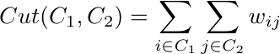
Simpler problem: partition into two cluster
The cut between two subgraphs is calculated as follows

Slide 82
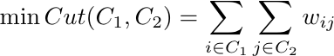
Intuition
The minimum cut of a graph identifies an optimal partitioning of the data.

Slide 83
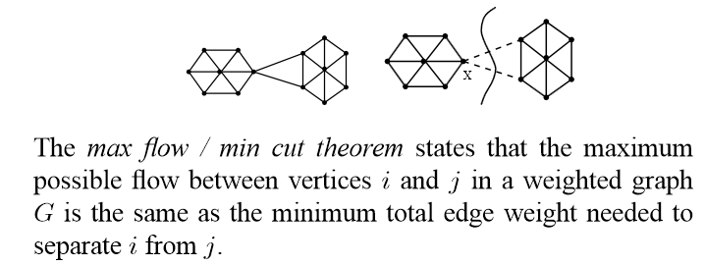
Good news!
Min-Cut can be solved quickly!

Slide 84
What is the min cut?
Destination
Source

Slide 85
Bad News!
Can produce non-intuitive partitions
Destination
Source

Slide 86
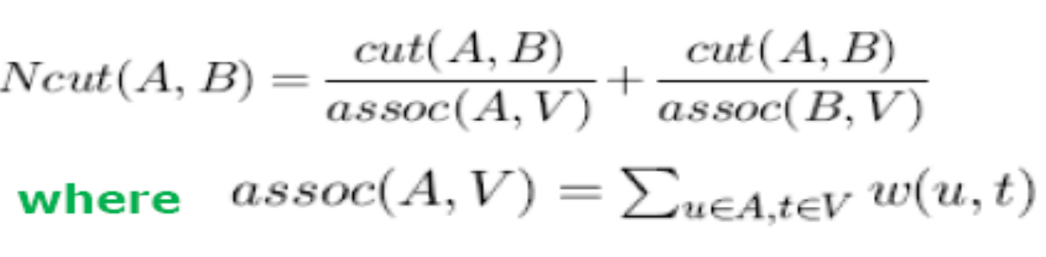
Solution
Normalize the cut
For G(V,E)
assoc(A,V)= summation of all edge weights from nodes in A.

Slide 87
Bad news again..
Normalized min-cut is NP-complete
Need heuristics
Spectral Clustering
Markov Clustering algorithm

Slide 88
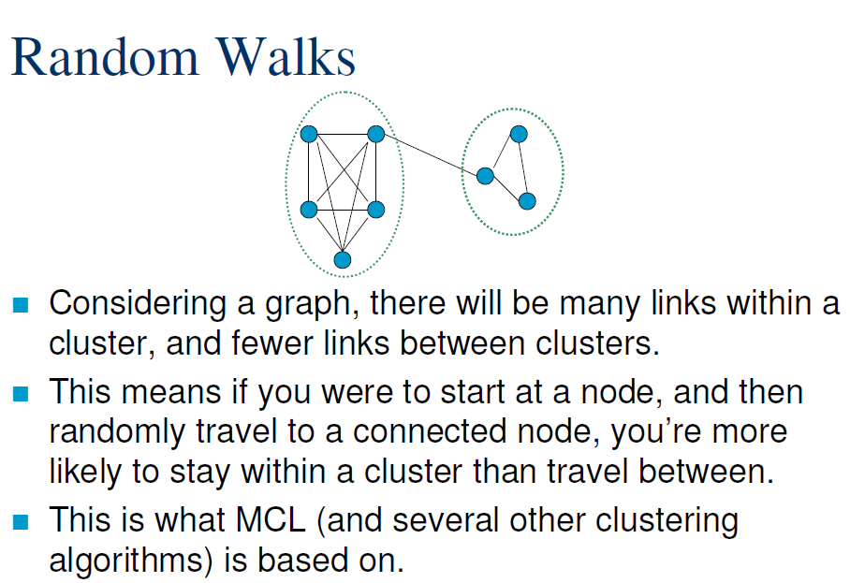

Slide 89
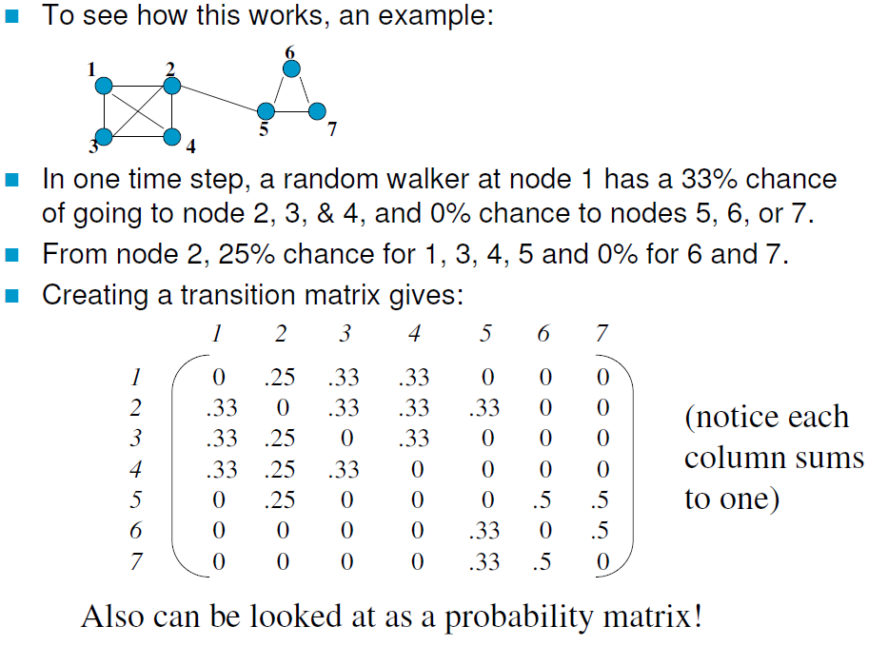
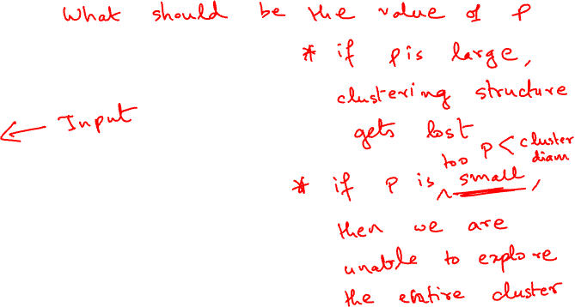
Random walks: Transition matrix

Slide 90
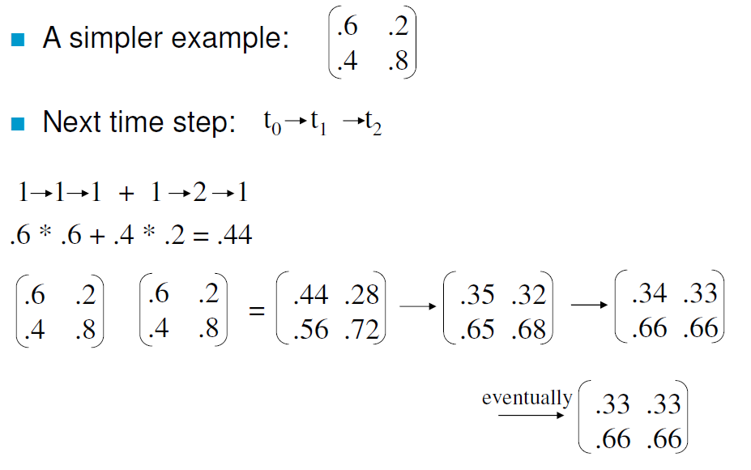
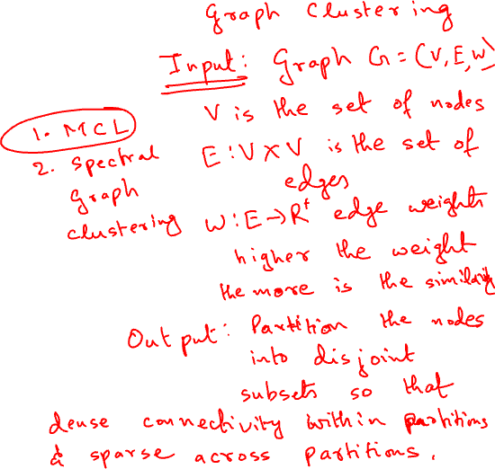
Multi-step transition matrix

Slide 91
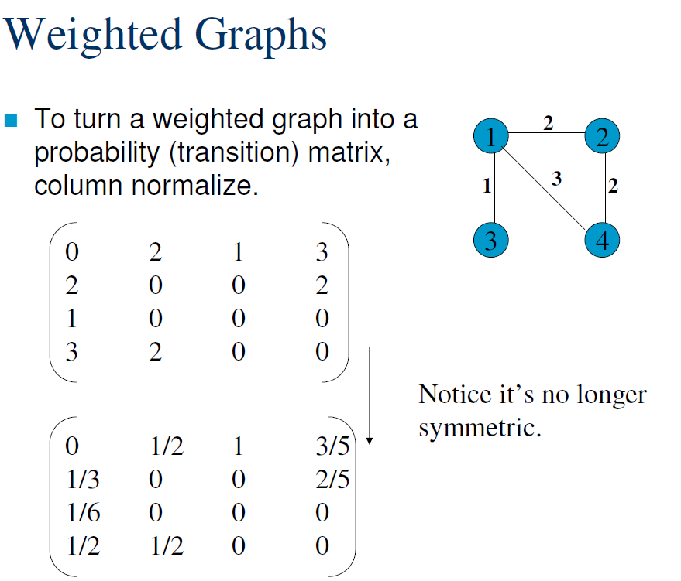

Slide 92
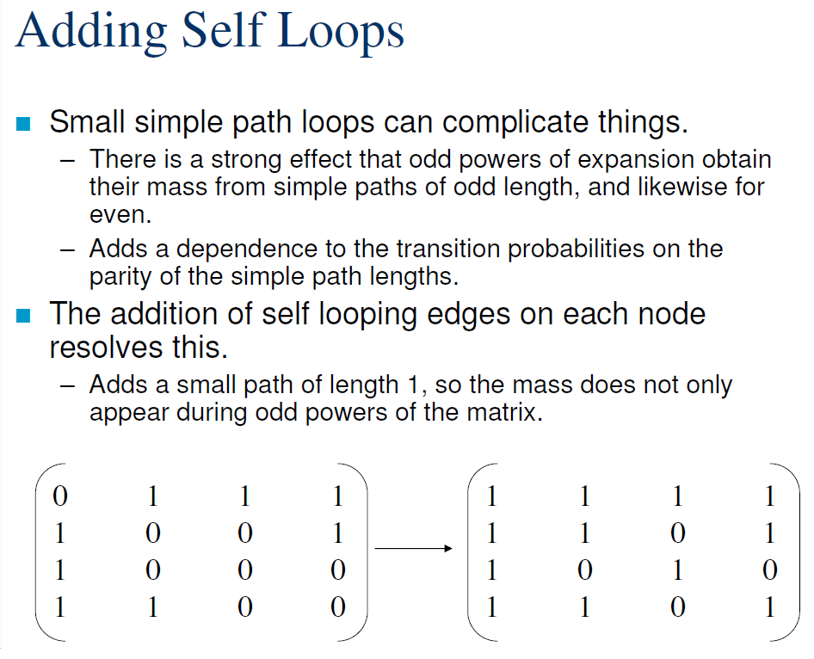

Slide 93
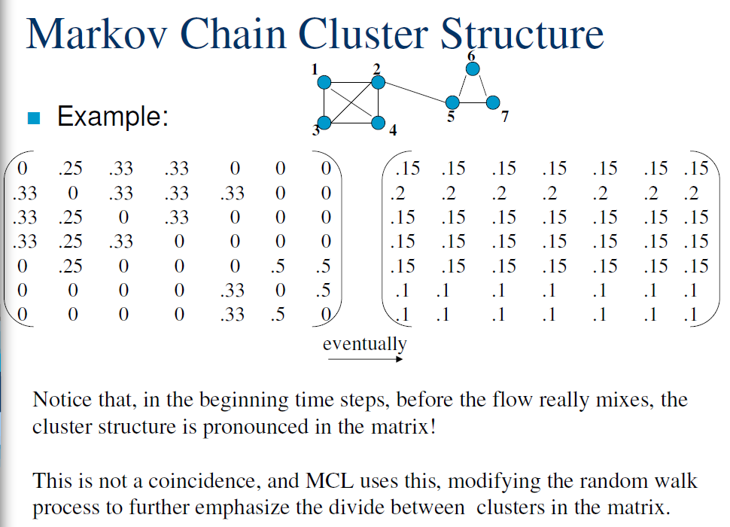

Slide 94
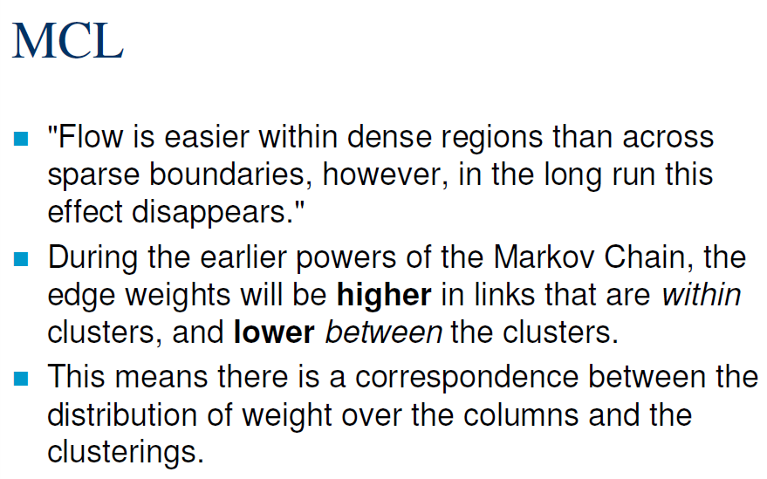

Slide 95
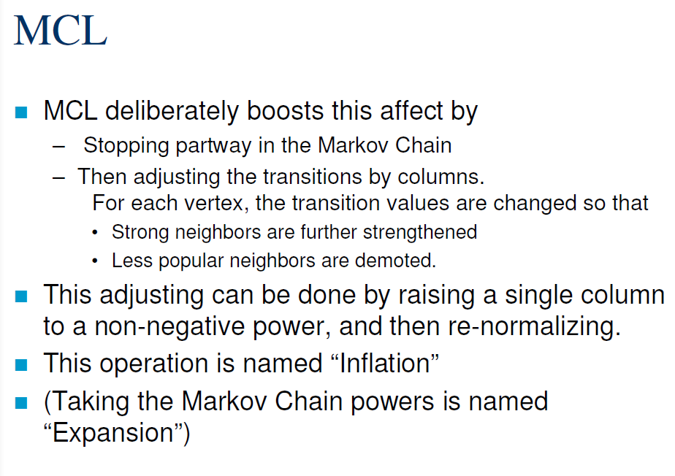

Slide 96
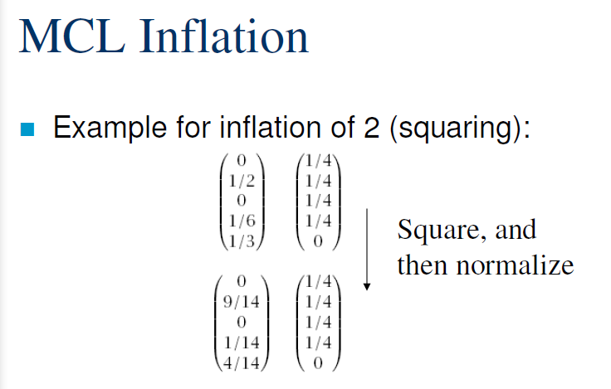
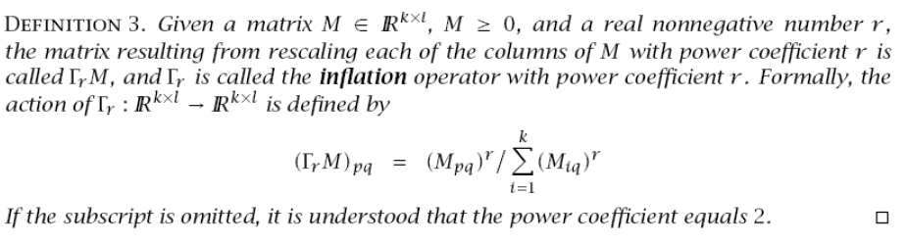

Slide 97


Slide 98


Slide 99


Slide 100


Slide 101



Slide 102


Slide 103


Slide 104


Slide 105


Slide 106



Slide 107


Slide 108


Slide 109


Slide 110
Effect of parameters
What would happen if inflation parameter is high Vs. low?

Slide 111


Slide 112
How about expansion?
Guides the diameter of the cluster

Slide 113

Complexity

Slide 114


Slide 115


Slide 116
Spectral Clustering: Topics to cover
Eigen vectors and eigenvalues
Orthogonality
Magnitude
Positive semi-definite matrices
Graph Laplacian of undirected, weighted graphs
Smallest eigenvalues and its relationship to connectivity
Second smallest (non-zero) eigenvalue and its relationship to addition or deletion of edges.
Application: Spectral clustering

Slide 117

Pipeline of spectral clustering
Compute Laplacian of the (undirected) graph: L=D-W
D= diagonal degree matrix
Degree(v)=$\sum_{∀e=(u,v)}{weight(e)}$
W=weight matrix
Symmetric
Rows and Columns sum up to 0
Positive-semidefinite
Eigenvalues $≥0$
Compute eigenvector,eigenvalues and sort in ascending order
Ignore the first eigenvector and then consider the top-k eigenvectors
Embed nodes in a feature space of k-dimensions
Cluster

Slide 118

Why is this a reasonable approach?
$Lx=λx$
$=$Since x is an unit eigenvector

